Slide 1
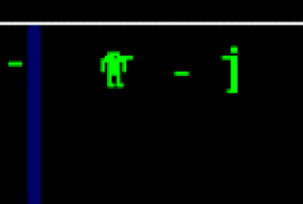
C++ Interfaces

Slide 2
There is no “interface” thing in C++
Other languages have promoted this to a real thing
This is really a technique
Make a class like usual
Make ONLY methods - NO DATA
Make them ALL virtual
Make the “pure virtual” (“= 0”)
Add a virtual destructor

